Slide 1


25Credit
9872 4908 2345 9898
1234
VALID TILL 12/19
Team: NAÏVE BAE-S

Slide 2
Introduction
Credit Card Fraud Detection
Credit card fraud is the most popular type of fraud
4 common characteristics which make it hard to detect fraud:
It is uncommon – Thus, hard to generate patterns
It is concealed – It is well hidden among thousands of legit transactions
Changes over time – Fraudsters keep getting smarter and finding new ways
Organized – Fraud is often organised and makes it even harder to detect
Solution has to have the following characteristics:
Lightning fast – Early detection is essential
Using predictive analytics with rules based strategies to ensure all fraud, whether it’s known or unknown, fast moving or slowly evolving, is detected and prevented before losses accrue.

Slide 3
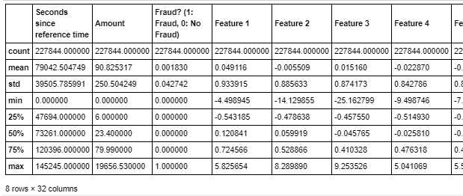
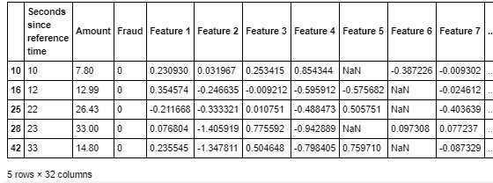

Exploratory Data Analysis
Summary Statistics
Features columns are generally similar in values range (due to PCA transformation)
Seconds since Reference Time & Amount have different scale.
Missing Values
Presence of Missing Values in 2 columns: Features 5 and 6
Duplicated Values
No duplicated Values

Slide 4
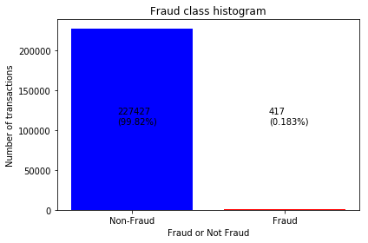
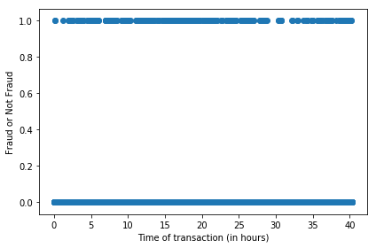
EDA
Fraud Class Analysis
Fraud Class Histogram
Scatter Plot of Fraud Class & Transaction Time
Indication of significant unbalance between data points for class “Fraud” and “Non-Fraud”
Pattern for both non-fraudulent and fraudulent transactions seems to be random regardless of hour of the day
Need to conduct resampling
“Seconds Since Reference Time” not a good predictor
Notes:
Fraud Class Analysis
Fraud Class Histogram
Scatter Plot of Fraud Class versus Seconds since Reference Time
Scatter Plot of Fraud Class versus Transaction Amount
Line Graph of Density of Probability for Fraud Class versus Transaction Amount

Slide 5
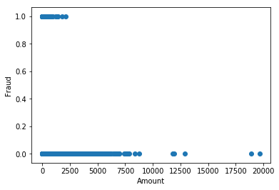
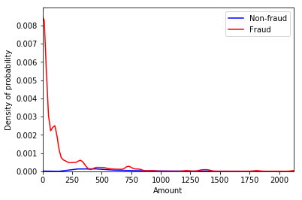
EDA
Fraud Class Analysis
EDA
Scatter Plot of Fraud Class & Transaction Amount
Line Graph of Density of Probability for Fraud
Fraudulent transactions more concentrated towards lower amount (<2500)
Density of probability for fraud is much higher for lower amount & it increases as the amount lowers

Slide 6
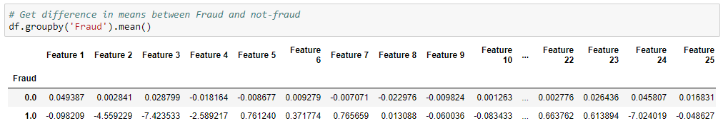
EDA
Insights from EDA
EDA
EDA
Check for outliers in both fraud and non fraud category
Feature 3
Feature 24
As we can see, certain variables (like `Feature 3`, and `Feature 24`) are drastically different for fraud and non-fraud categories. The company can keep these Features in view for early fraud detection analysis.

Slide 7
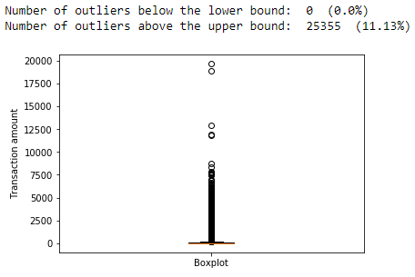
EDA
Anomaly/Outlier Detection
EDA
EDA
Rationale for not Removing Outliers
- Outliers are detected using interquartile range method
- Removing them from the dataset would be a bad idea due to the loss of a large amount of information for the machine learning models. In addition to that, only 75 out of 25355 outliers are classified as frauds.

Slide 8







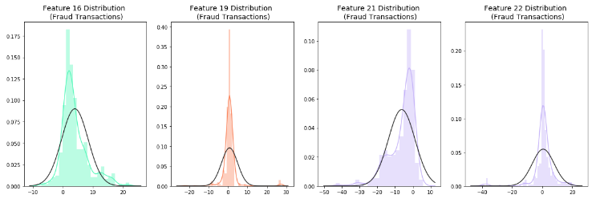
EDA
Anomaly/Outlier Detection
EDA
EDA
Feature 16
Feature 19
Feature 21
Feature 22
Rationale for not Removing Outliers
Outliers are value adding for fraud detection classification model
Notes:
Since Feature 16, 19, 21 and 22 has much higher range (between 76 to 95) as compared to the rest, we will check for the distribution plot of these features.
Even though the features contains outliers, these outlier values adds value to the fraud detection classification model

Slide 9
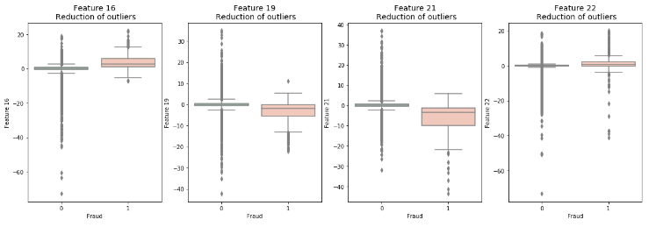
EDA
Anomaly/Outlier Detection
EDA
EDA
Feature 16
Feature 19
Feature 21
Feature 22
Rationale for Not Removing Outliers
Outliers values are present in both “Fraud” and “Non-Fraud” class labels If we remove the 75 Fraud outliers, our dataset will become more imbalanced

Slide 10
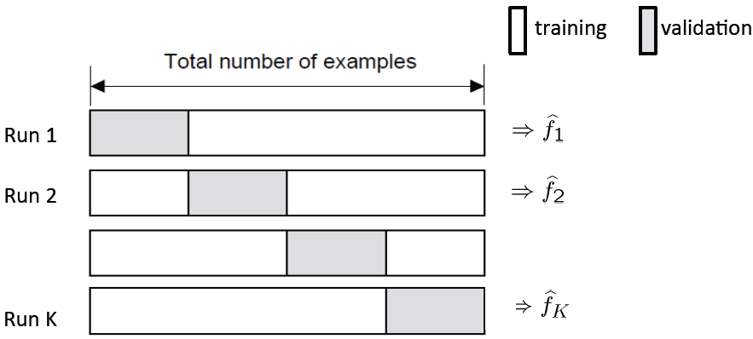
Splitting of Dataset
Train Set
Test Set
80%
20%
K-fold Cross-Validation
Test Set: to be used for model evaluation metrics
Training Set: used for model training while k-fold cross validation is used for parameter tuning
Notes:
Source: https://towardsdatascience.com/train-validation-and-test-sets-72cb40cba9e7

Slide 11
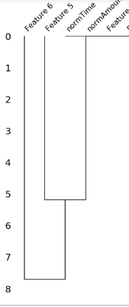

Data Cleaning – Missing Values
NULLITY CORRELATION MATRIX HEATMAP + DENDROGRAM
Analysis:
There is a relationship between normAmount and the missing values for Feature 5
There is also a relationship between missing values for Feature 5 and Feature 6
F5
F6
F5
F6
Marginal Correlation (0.1) bet the presence of absence of F5 & that for F6
Notes:
The missingno correlation heatmap measures nullity correlation: how strongly the presence or absence of one variable affects the presence of another. In this case, it shows that only Feature 6 and 5 are missing and there is a 0.1 correlation between the missing values in these two columns.
Dendrogram interpretation:

Slide 12



Data Cleaning – Missing Values
CHECK FOR PRESENCE OF MISSING VALUES
Feature 5
Feature 6
Only Feature 5 and 6 has missing values while the percentage of missing values over whole dataset is below 3%
Data NOT Missing Completely at Random (MCAR)
Hard to distinguish bet Missing at Random (MAR) and Missing Not at Random (MNAR)
Features definition and contexts are unknown
SOLUTION : MULTIPLE IMPUTATION (using sklearn by mean values)
Notes:
Dropping the rows will make the model biased and we will be using Imputation instead

Slide 13
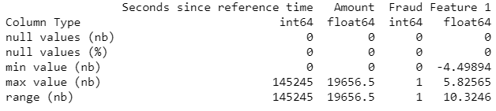
Data Transformation - Normalization
CHECK FOR ATTRIBUTE VALUES RANGE
Seconds Since Reference Time
Rational for Normalization
Time Sequence
Wide Range
adds additional weight on the features for prediction model building
Amount
Wide Range
Notes:
Since the value of amount and time have a very different scale from the rest, we should consider normalising the columns "Amount" and "Seconds since reference time"

Slide 14

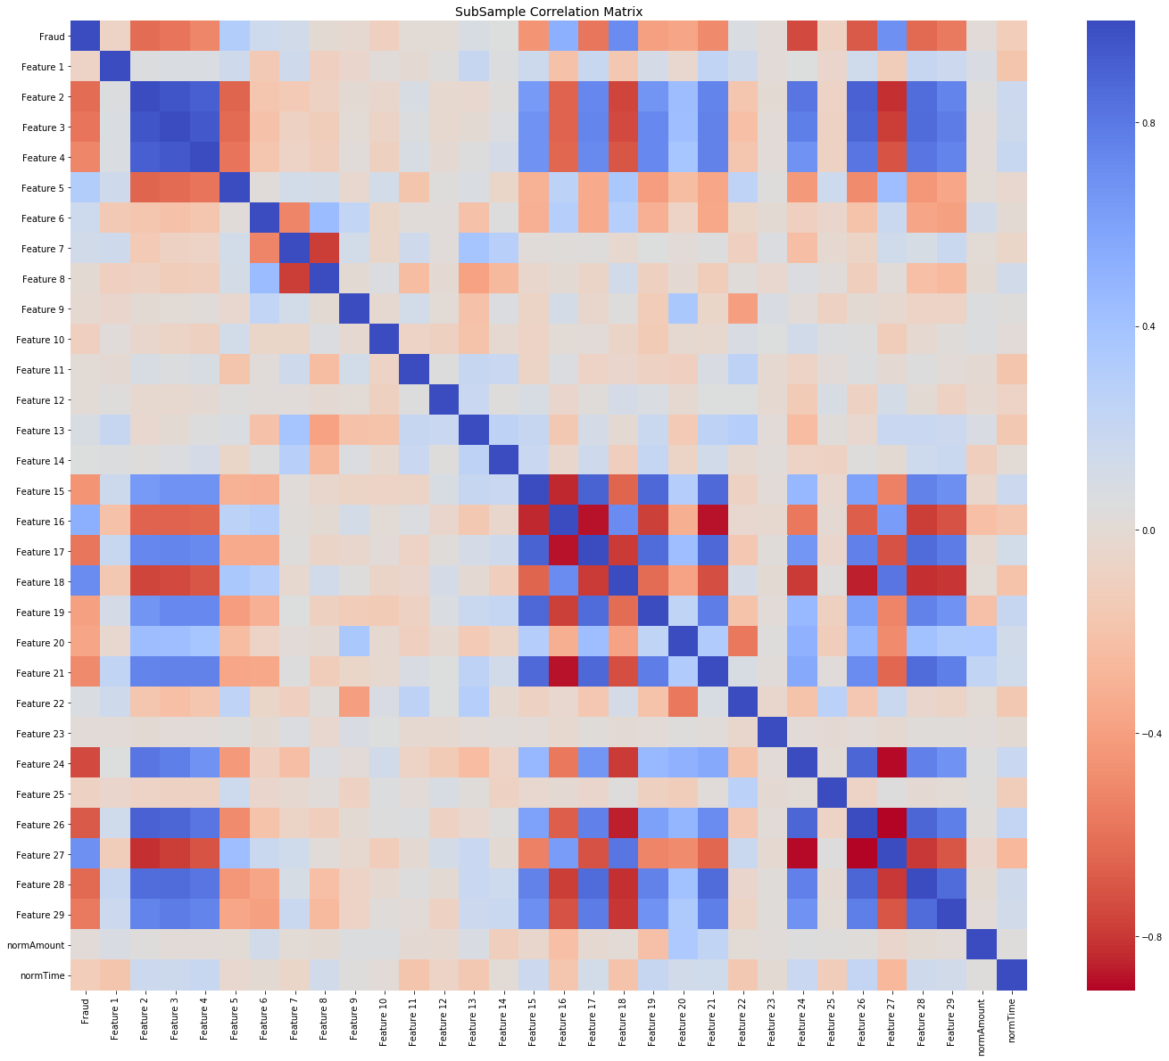
Feature Selection
Data Shuffling
Correlation Matrix
Random Forest
Step Forward Feature Selection
Parameters
No of Trees: 1000 K_features: 17
Scoring: Accuracy
Parameters
Normal Distribution
Frac: 1
Random_state: 42
Remove Features with high positive or negative correlation
[Features 7, 16, 27, 2, 21]
Selected Feature:
0, 1, 2, 4, 6, 8, 9, 10, 11, 14, 15, 17, 18, 19, 20, 21, 23
Minimize bias and patterns in the training dataset
Notes:
Data Shuffling: avoid element of bias / patterns in the split datasets (after splitting into training, testing and validation datasets) before training the ML model and subsampling → Improve ML model quality + Improve predictive performance
Correlation Metrics:
Negative Correlations: Features (7 and 8), (15 and 16), (16 and 17), (16 and 21), (24 and 27), (26 and 27) are negatively correlated.
Positive Correlations:Features (2,3, and 4), (2 and 26), (15 and 21) are positively correlated. Notice how the higher these values are, the more likely the end result will be a fraud transaction.
So now we will be removing features 7, 16, 27, 2, 21

Slide 15
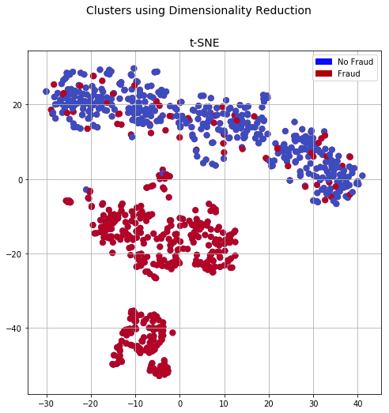


Data Resampling
T-distributed Stochastic Neighbour Embedding
Synthetic Minority Over-sampling Technique
Nonlinear Dimensionality Reduction Technique for Visualization of Clusters
Higher Performance than Conventional Oversampling and Undersampling
Parameters
Sampling Strategy = 0.67
Kind = regular
Parameters
N_components = 2
Random_state = 42
Notes:
t-SNE tells us if our prediction model will correctly able to cluster our training set datapoints correctly. From the plot above, we can see that the data can be classified into fraud and non-fraud and thus, we will be moving forward with it N_component = 2 because 2 classes., Random_state=42 so it's easy to re-run and test
SMOTE: it creates synthetic (not duplicate/replicate) samples of the minority class. Hence making the minority class equal to the majority class. SMOTE does this by selecting similar records and altering that record one column at a time by a random amount within the difference to the neighbouring records.

Slide 16
Model Selection
Classification Model
Ensemble Methods Model
Logistic Regression
Random Forest
Decision Tree
Assumption
The dataset is highly unbalanced, and hence we simulate fraud cases to balance the non-fraud cases
The features include only numerical input variables which are the result of a PCA transformation
We presume the model is incremental in nature, where new user information keeps getting added to the current dataset to help in future fraud prediction
Notes:
SVM: not suitable for large datasets because of its high training time

Slide 17
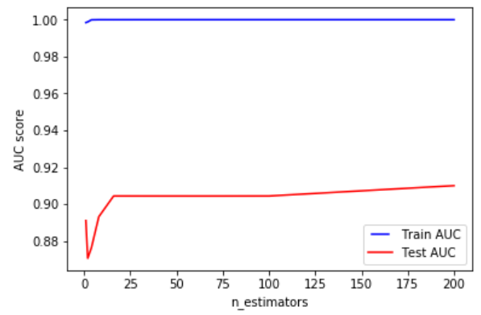
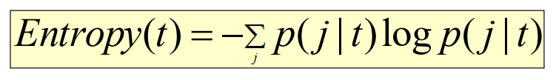
Bagging – Random Forest
Parameter Consideration
N_estimator: 24
Splitting Criteria: Entropy
p( j | t) is the relative frequency of class j at node t
Reasons: Chose point when Test AUC starts to decrease over time
Reasons: Entropy gives better information gain than Gini Index and Misclassification Error

Slide 18

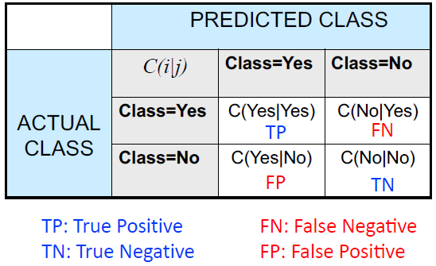
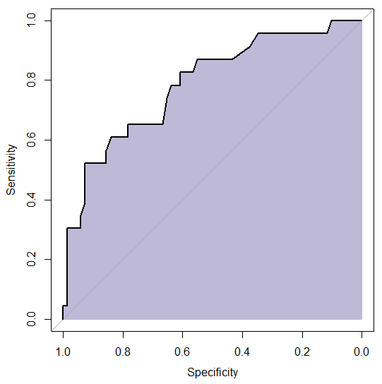


Evaluation Metric
Confusion Matrix
AUC Curve
Precision
Recall
F1-Score
2
2 TP
2 TP + FP + FN
Notes:
What evaluation metric we have chosen to evaluate our model and is it the most appropriate for the type of dataset?

Slide 19
Evaluation Metric
Accuracy
Inappropriate for imbalanced dataset due to higher likelihood in predicting the class label to be non-fraud
Precision
Shows fraction of relevant instances among retrieved instances → Inappropriate due to precision bias
Recall
Shows fraction of relevant instances over total relevant instances → Inappropriate due to recall bias
F1-Score
Balance no of fraud detected and minimize no of fraud falsely detected → Balance precision and recall trade-off
AUC
Suitable to evaluate binary classification model → Higher AUC means higher predictive power
Notes:
Accuracy
In appropriate for imbalanced dataset as the model will be more likely to predict the label to be non-fraud given the smaller number of fraud cases. Accuracy is used very specifically for the dataset with equal number of records for fraud and non-fraud.
Confusion Matrix - precision, recall, F-score
F-score: balance precision and recall trade-off
is calculated to balance the number of frauds detected and minimise the number of frauds falsely detected
Area under Curve
We will use AUC (Area Under Curve) as the evaluation metric for parameter tunings for our Random Forest model. As we are working on classification predictive model, AUC is a more appropriate way for evaluation.
Given a random fraud case and a random non-fraud case, proportion of the time the model predicts a higher probability of fraud care to the fraud-care case.

Slide 20
Model Evaluation
Model | Precision | Recall | F1-Score | AUC Score
Logistic Regression | 0.83 | 0.58 | 0.68 | 0.9556
Decision Tree | 0.36 | 0.8 | 0.49 | 0.897
Random Forest | 0.89 | 0.82 | 0.85 | 0.968
Final Classifier: Random Forest due to with high AUC score (0.968) and F1-Score (0.85)

Slide 21
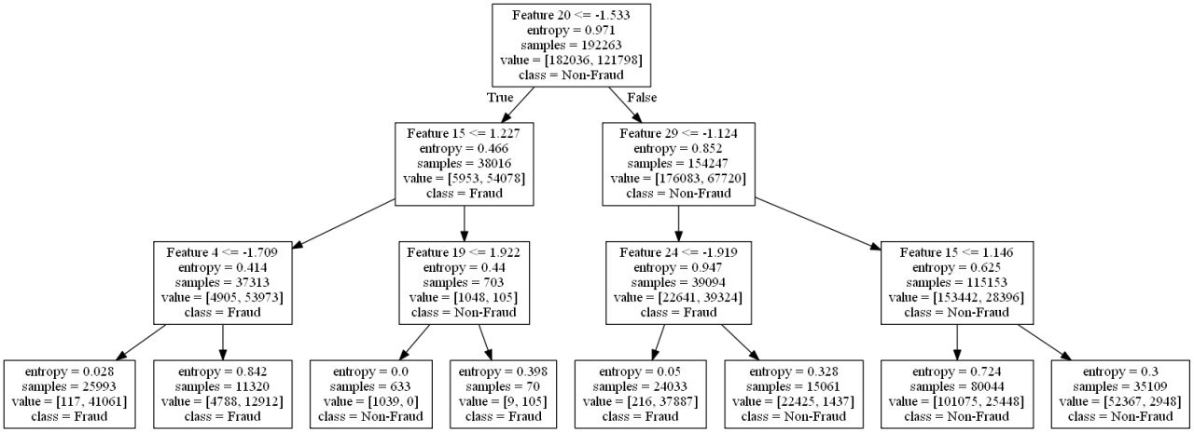
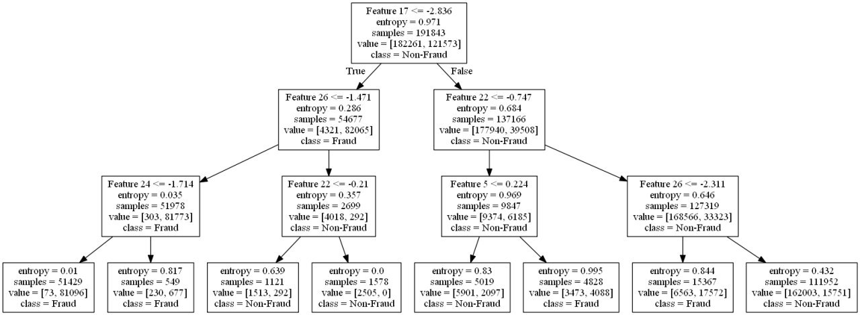
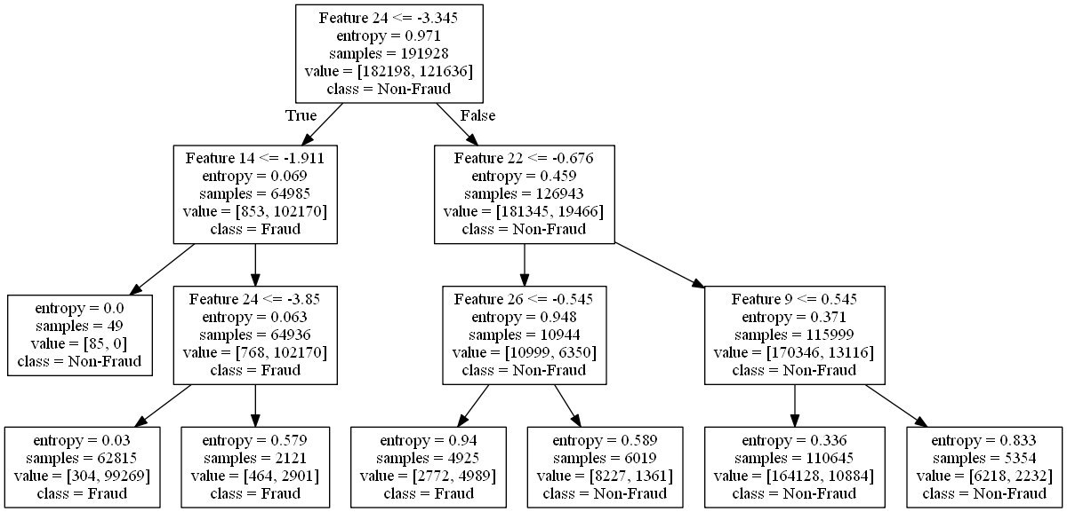
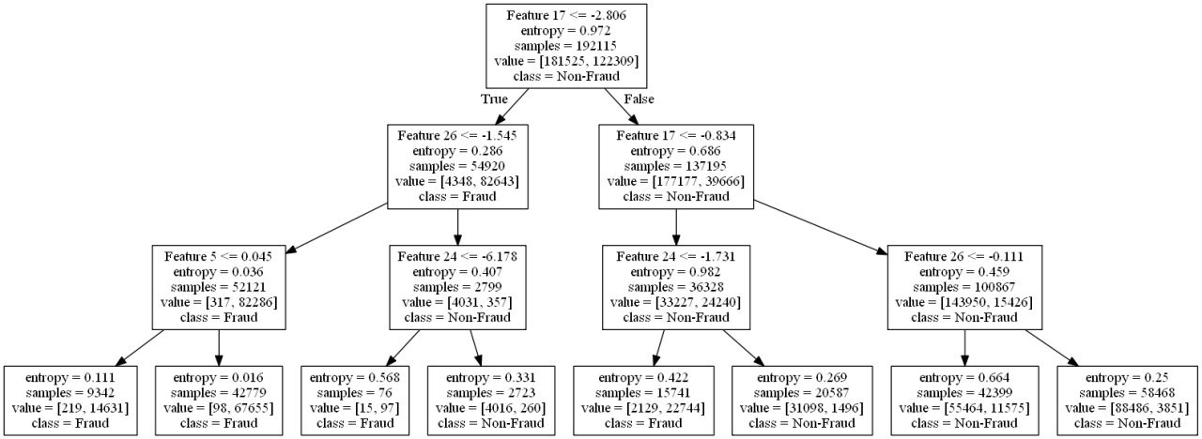
Bagging – Random Forest
4 trees are randomly printed
→Primary Indicator: low value for Feature 24 (<1/7) implies a Fraudulent transaction
Notes:
From the 3 decision trees w eselected randomly and printed, we found the following 2 insights:
1. Low value for Feature 24 (<-1.7) implies a Fraudulent transaction
Thus, we can keep an eye out for features 24 as preliminary indicators for fraud.

Slide 22
Bagging – Random Forest
3 trees are randomly printed
→Primary Indicator: low value for Feature 26 (-2) and 17(-2.8) implies non-fraudulent
Notes:
2. Low value for Feature 26 (-2) implies a non-Fraudulent transaction
3. Low value for Feature 17 (-2.8) implies a non-Fraudulent transaction rgb(22, 160, 133)
Thus, we can keep an eye out for features 26 and 17 as preliminary indicators for non-fraud.

Slide 23
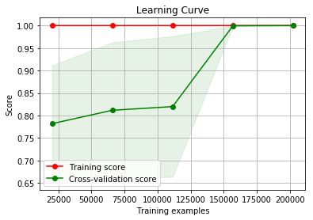
Futher Evaluation
Bias Variance Trade-off
Learning Curve
For final model, bias-variance trade-off is good due to merging of training and cross-validation score → robust and good model

Slide 24
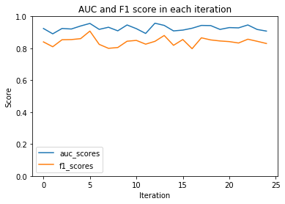
Futher Evaluation
K-fold Cross Validation
AUC & F1 Score for each of the 25 Iterations
Minimal fluctuations in F-1 and AUC scores → lack of overfitting / overfitting

Slide 25
Business Solution- Model Application
Real-Time Analysis
Run model in real-time to predict whether transaction is fraudulent or not.
Since the model is not 100% accurate, we request that the company just flag the transaction and conduct further investigation before labelling it as fraud
Flag Transaction
Live model test
First the model must be put into live server but not affect any decisions to be made. This will train the model well
EDA
Other than predicting, the model can be used to get more insights from the data

Slide 26
Business Solution- Further Solutions
Business Solution- Model Application
As seen from EDA, fraud transactions are generally in the lower transaction amount category. Thus, the company must counter-intuitively focus on lower amounts instead of higher ones
Transaction Amount
We have observed that feature 24 is a peculiar feature based on the range as well as the business rules showcased by Random Forest. Thus, this feature is a good indicator of fraud and must be observed
Feature 24

Slide 27
Business Solution- Further Solutions
Data Points Enhancement
Gather more data (especially fraudulent transactions) so that the model can be trained better and accuracy can be improved. → large dataset allows building of more robust model (e.g. deep learning models)
Risk Culture Building
Foster a risk-intelligent culture and empower employees at every level to take informed decisions if the model flags a transaction as fraud
Business Domain Knowledge
Add additional weightage to important features based on business domain knowledge
User Behaviour
Study
Study the user behaviour mouse-clicks, time spent on website, etc as feature as well to predict fraud
Geospatial Analysis
Apply geospatial analytics to study the location for transactions (real address or IP address) and use spatial analysis to detect any anomaly

Slide 28
Business Solution- Limitations and Constraints
Complexity
Parameter Tuning require higher computational complexity to derive the most optimal solution
Anonymized features → difficult to do feature engineering
Without understanding features context , it is difficult to find correlation between features and conduct further feature manipulation (e.g. Feature 5 + Feature 6) + Data Imputation would be improved with feature understanding
Feature Engineering
Time Dimensionality
If we had a time dimension in the data (Day/month/year etc) then we could have identified more patterns in terms of when fraudulent transactions occur.
Fraud Categories and Type
If we had categories of transactions then we could have identified further patterns → model will not be able to detect a new fraud type if it occurs unless the model is re-trained

Slide 29
Business Solution- Future Improvements
Parameter Optimization (GridSearchCV)
- Due to GPU limitation, we did not manage to use this→Require more computation
Model Stacking
-Enhance model AUC and F1 Score through complex model stacking
Other Model Selections
- K-NN, Naïve Bayes, Boosting: XGBoost, LightGBM, CatBoost, AdaBoost
- Create an ensemble learning algorithm with multiple models
- We tried but the result was surprisingly worse
Fraud Probability Model Building on top of Fraud Classification Model
- single transaction information is not considered sufficient to detect a fraud occurrence
Fraud Types Continuous Evolution
- Detection has to adapt to fraudsters. Once a fraud is well detected, the fraudster could change his habits and find another way to fraud. Adaptive schemes are therefore required to deal with non-stationary fraud dynamics and discover potentially new fraud mechanisms by itself.

Slide 30












Final Conclusion
Collect Diverse Data
Pre-process data
Implementation
Decision Choice
User data
Missing values
Detect fraud
Investigate transaction
Transaction
data
Feature Selection
Profile users
Accept/Reject transaction
Client
data
Imbalanced data
Calculate Score
Restrict future transactions

